Slide 1
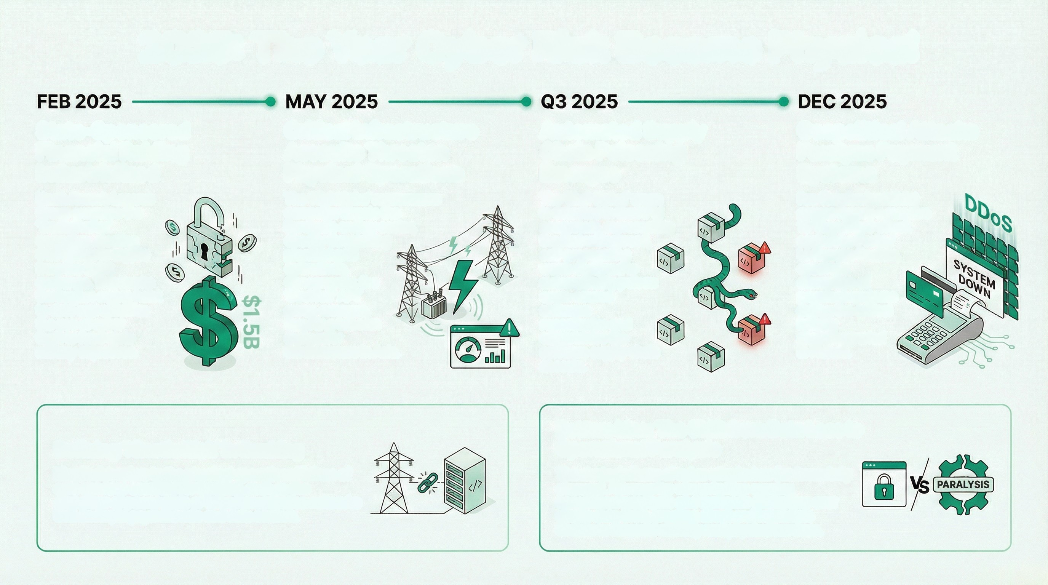
2025: The Year Cyber Risk Became Physical
State-Sponsored
Financial Raiding
Industrialized
North Korea's Lazarus Group executes the 'Trader Traitor' campaign, stealing
$1.5 Billion in crypto
from the Bybit exchange.
This marks the largest
crypto heist to date and solidifies the use of cyber
theft to fund state military objectives.
Critical Infrastructure
Assaults Threaten
Physical Operations
Automated Supply
Chain Poisoning
Emerges
The 'Shai-Hulud' worm
is detected in the NPM
ecosystem, representing
the first widespread,
self-propagating
worm designed to
automatically poison
open-source software
repositories and
compromise the
software supply
chain at scale.
Geopolitical Attacks
Paralyze Payment
Systems
The 'NightSpire' ransomware
campsign targets the
European energy sector,
directly threatening
physical grid
operations.
Concurrently, the
'DireWolf' APT
group emerges,
targeting telecom
and power infrastructure
in Asia.
Pro-Russian hacktivist
groups launch a massive
10 Tbps DDoS attack
against La Poste /
La Banque Postale,
causing a disruption of
payment systems
during the crifical
holiday shopping
period in France.
Defining 'Kinetic Risk' in Banking
Kinetic risk refers to the physical operational failure of core services essential for banking, such as the disruption of power grids or telecommunication networks that underpin payment rails and data centers.
Bottom Line: The Shift from Data Loss to
Operational Paralysis
The strategic focus of cyber attacks has
fundamentally changed. Adversaries now
prioritize causing operational paralysis and
systemic disruption over simple data theft, creating direct
and immediate threats to financial stability and physical services.

Slide 2
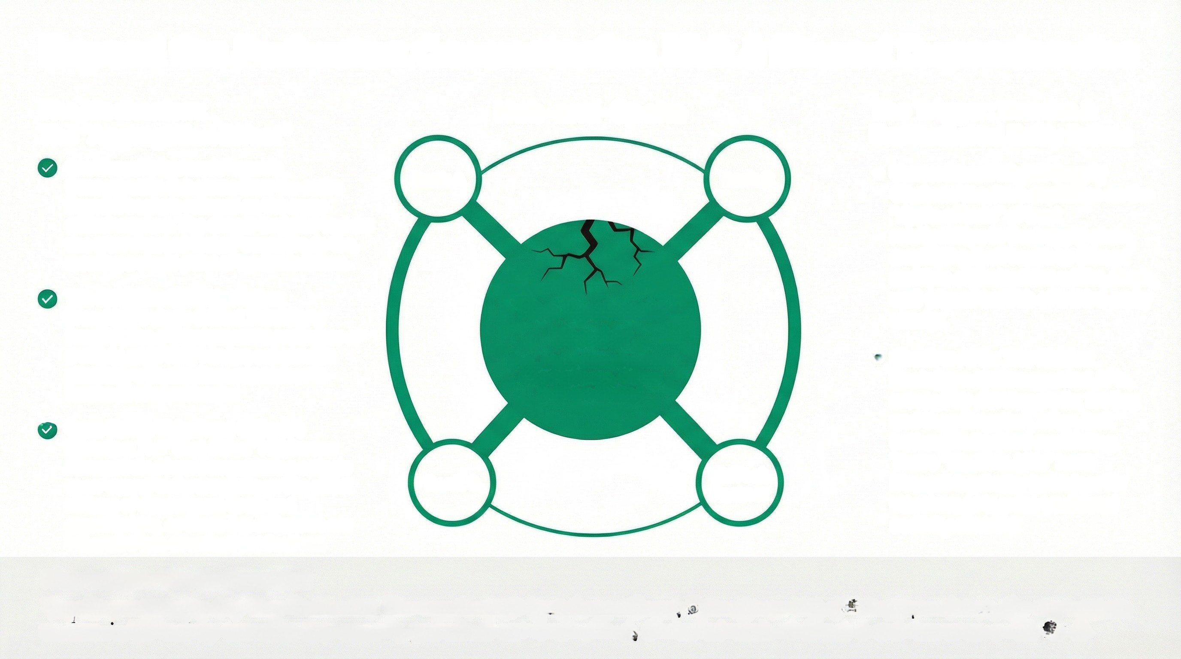
Beyond the Perimeter: Concentration Risk & Shared Dependencies
The Mechanism:
The "Aggregation Effect"
Hub-and-Spoke
The Trigger: Unseen &
Unmonitored Entry Points
• Unmonitored Digital Supply
Chains: Attackers capitalize on the
"ripple effects" of trust
relationships in the supply chain,
amplifying their reach to disrupt
multiple organizations with a single,
well-placed breach of a third-party
vendor.
One Breach, Systemic Impact:
Concentration risk stems from the entire
financial sector's reliance on the same
critical vendors. The danger isn't just that we
use a service, but that all our peers do too,
creating a single point of systemic failure.
Bank A
Bank B
The Multiplier Effect in Action:
Breaching a single Critical Third-Party
Provider, like a cloud payment processor or
a widely-used KYC vendor, can provide
attackers with simultaneous access to
hundreds of client banks.
The Systemic
Vendor
(e.g., Major Cloud Provider,
Clearing House, Critical
Software Library)
• Shadow APIs: The Hidden
Backdoor: Undocumented APIs,
created by developers for testing
and then forgotten, often lack
authentication and monitoring.
These "Shadow APIs" have
become a primary backdoor for
attackers to bypass traditional
security controls.
Case Study: Ubiquitous Software
Librarles: The "Shai-Hulud" NPM worm
demonstrated how compromising a single
open-source software package can afect
millions of downstream users and
organizations, as these dependencies are
integrated into countless applications.
Bank C
FinTech
Partner
Risk Insight: The Bottom Line
Your Dependencies Are Your Perimeter. The supply chain is no longer linear; it is a dense web of interdependence. Our true attack
surface is defined by the collective security posture of our most critical, shared vendors. A failure in one becomes a risk for all.

